Slide 1
Android Fundamentals
Lecture 2
Tom Karni, Itsik Avidan

Slide 2
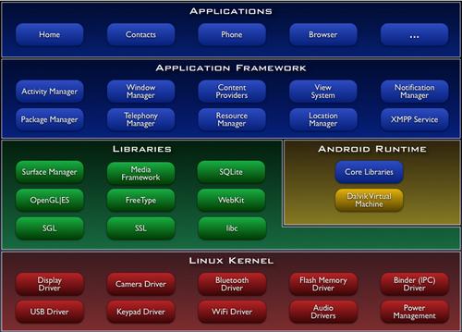
Architecture
Notes:
Linux Kernel Android relies on Linux for core system services such as
memory management,
process management,
network stack,
security,
and driver model.
Acts as an hardware abstraction layer between the applications and all the hardware.
Android Runtime The Dalvik VM is backward-compatible with Java SE Development Kit (JDK) 5.0 but optimized for the Android Platform.
Android application runs in its own process.
Android application owns its own instance of the Dalvik virtual machine.
Dalvik has been written so that a device can run multiple VMs efficiently.
Libraries
C/C++ libraries
standard C system library (libc), tuned for embedded Linux-based devices
3D libraries - an implementation based on OpenGL ES
SQLite - a powerful and lightweight relational database engine
And more…….
Application Framework
Just a few words about the components.
More detailed explanation later.

Slide 3
Linux kernel
Android relies on Linux for core system services such as:
memory management
process management
network stack
security
driver model
Acts as an hardware abstraction layer between the applications and all the hardware.

Slide 4
Android runtime
The Dalvik VM is backward-compatible with Java SE Development Kit (JDK) 5.0 but optimized for the Android Platform.
Each Android application runs on its own process.
Android application owns its own instance of the Dalvik virtual machine.
Dalvik has been written so that a device can run multiple VMs efficiently

Slide 5
Libraries
C/C++ libraries.
standard C system library (libc), tuned for embedded Linux-based devices.
3D libraries - an implementation based on OpenGL ES.
SQLite - a powerful and lightweight relational database engine
More …

Slide 6
Application Framework
ActivitiesViews lists, textViews editTexts, Spinners, Buttons, MapView, browser…
Content Providers access data from other applications (such as Contacts), or to share their own data.
Resource Manager making non-code resources (graphics, accessible strings, and layout files) accessible from code.
Notification Manager Alerts in the notification area.
Activity Manager Manage application lifecyle.

Slide 7
Application build
Creation process
Code written in java compiled with standard java compiler – javac to *.class files
Android SDK dx tool converts and binds the class files to *.dx files (DVM-compatible)
aapt and apkbuilder utility programs zip the .dex files to a single .apk file.
Computer
Device
.java
JDK
javac
.class
ADK
dx
.dx
ADK
aapt apkbuilder
.apk
ADK
Adb install
DVM

Slide 8
Application Components
Activities
Services
Broadcast receivers
Content Providers
The essential building blocks of an Android application
Each component exists as its own and plays a specific rule.
Each component can perform as the application entry point.

Slide 9
Application Components
Activity :
Represents a single UI screen in the application
Each Activity is independent of the other Activities in the application
Allow applications to start other application in a specific Activity
Extends the Activity.class

Slide 10
Application Components
Service :
Runs in the background of the application
Performs long-running operations – RPC & IPC
Service forms :
Started – startService()
Bound – bindService()
Extends the Service.class

Slide 11
Application Components
Content Provider :
Manages the application data
Represents the data
Device’s File system
SQLite DB table
Other
Using it, other applications can access the application data
Extends the ContentProvider.class

Slide 12
Application Components
Broadcast Receiver :
Responds to broadcast announcements in the system.
Doesn’t affect the user interface, but may create a status-bar notification
Intend to do minimum amount of work
Extends the BroadcastReciver.class
Delivered as an Intent

Slide 13
Activating Components
Activity , Service & Broadcast receiver – activated by Intent
Content Provider – activated by Content Resolver, handles all the direct transactions with the Content Provider.

Slide 14
Activating Components
Intent – asynchronous message, bind individual Components at runtime
Defines the action to perform & specify the data URI to perform on
Can start an Activity which will return a result, in this case the result will return as an Intent

Slide 15

Project Structure
src
res
layout
menu
values
drawable

Slide 16
The Manifest File
For each application, the OS validates that all of its Components exists in the application package and it has all of the needed privileges & hardware
The “AndroidMenifest.xml” file :
Identify any user permissions the application requires
Declare the minimum API level
Declare hardware and software features used or required by the application

Slide 17
Activity : Manifest declaration
Each Activity must be declared in the manifest file
There are several attributes that you can include to define properties such as the label, icon etc.
Intent Filters :
The Activity tag, can contain the <intent-filter> tag
Declares other applications may activate the Activity

Slide 18
Activities : Creation
Created using the Intent
startActivity()
startActivityForResult()
Activity entry point – onCreate()
An abstract method that must be implemented, Called when the activity is starting.

Slide 19
Activity : User Interface
The UI is provided by a hierarchy of Views.
The Views can by set by :
layout *.xml file using the setContentView(int layoutId) method
By code in the Activity
Combination of the above

Slide 20
Activity : Shutting down
You can shut down the Activity by
calling its finish() method
Call finishActivity() from the Activity who started it
The best practice is to let the OS finish Activities

Slide 21
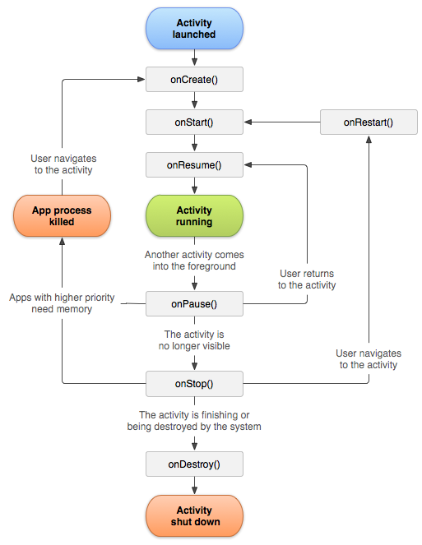
Activity : Life-Cycle
Stopped :
In the background, alive and kept in the memory but not visible to the user
Paused :
Visible but don’t has the focus
Resumed :
In the foreground of the Screen & has the focus

Slide 22
Method | Description | Killable after ? | Next
onCreate()
onRestart()
onStart()
onResume()
onPause()
onStop()
onDestroy()

Slide 23
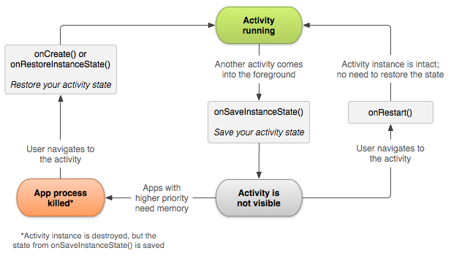
Activity : Saving state
When the Activity is destroyed by the OS, all of its data can’t be resumed
The user is unaware of the Activity state and expects to return to it previous Activity
save information upon destroy using onSaveInstanceState()

Slide 24
References
Android developers [http://www.android.com/develop] [http://developer.android.com/guide/components/fundamentals.html]
Sayed Y. Hashimi ,Satya Komatineni, “Apress – Pro Android”, 2009.
Android Development Community | Android Tutorials [http://www.anddev.org/]

